Slide 1
EEG-based Affective Computing
with VGG16 and LSTM Hybrid Model
Student: Yingnan Xu
Student ID: 218012045
Professor: Zhenglong Sun

Slide 2
01
Target
02
Data & Label
CONTENTS
03
Feature Image Sequence
04
Model
05
Evaluation
06
Conclusion

Slide 3
PART
ONE
Target

Slide 4
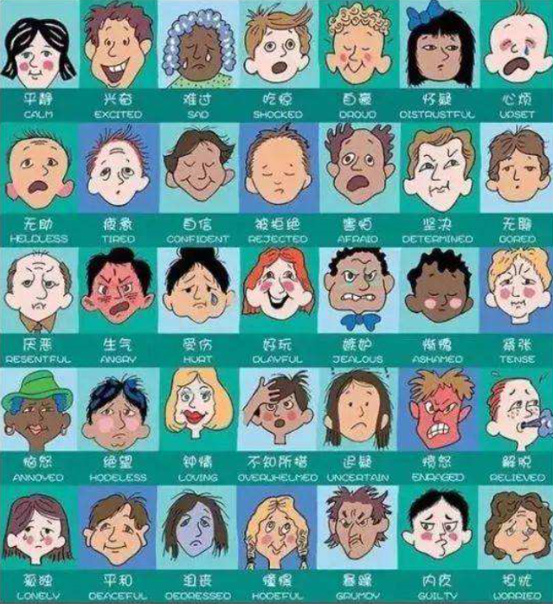
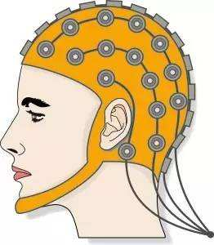
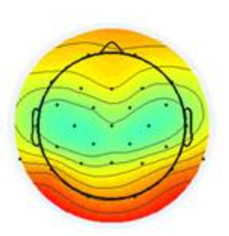
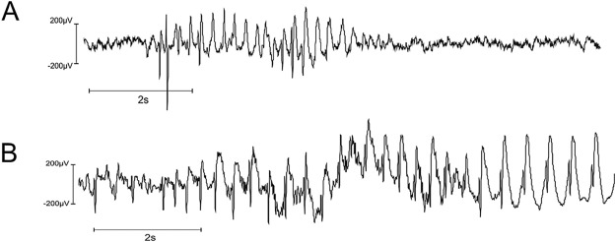
Research Significance & Target
Significance of Emotion Recognition
Emotion Recognition is a brunch of Affective Computing (enable computer to recognize, understand, express and respond to human emotions).
Can we use wearable devices to detect emotion？By “Scientific American”: 20 big questions about the future of humanity.
Human Computer Interaction, HCI: recognize the emotion states of users, making techniques more human-friendly and improving user's experience.
Medical Care: diagnose the emotional states of patients with mental diseases.
Aviation Accident: assess the emotional state of pilot.
Compared with traditional emotion recognition method like expression, gesture, heart rate, skin response, etc, electroencephalogram(EEG) emotion recognition is more reliable. e.g. Affective Brain-Computer Interaction(BCI).
Target: EEG-based Affective Computing：relationship between EEG signal and Human Emotion.

Slide 5
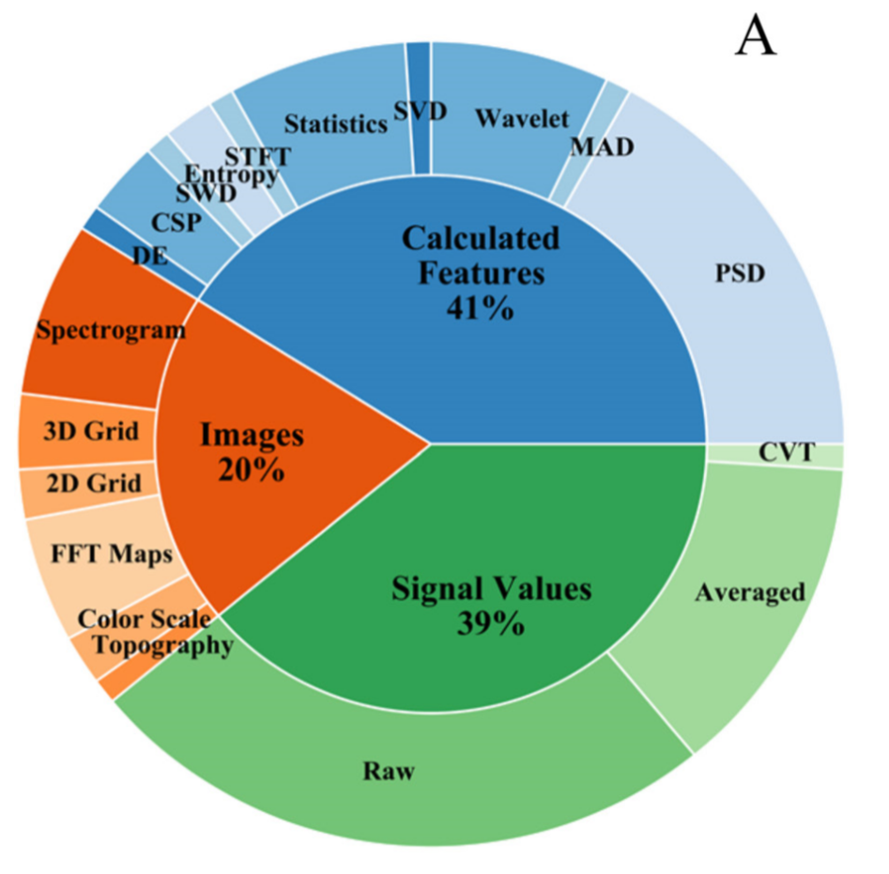
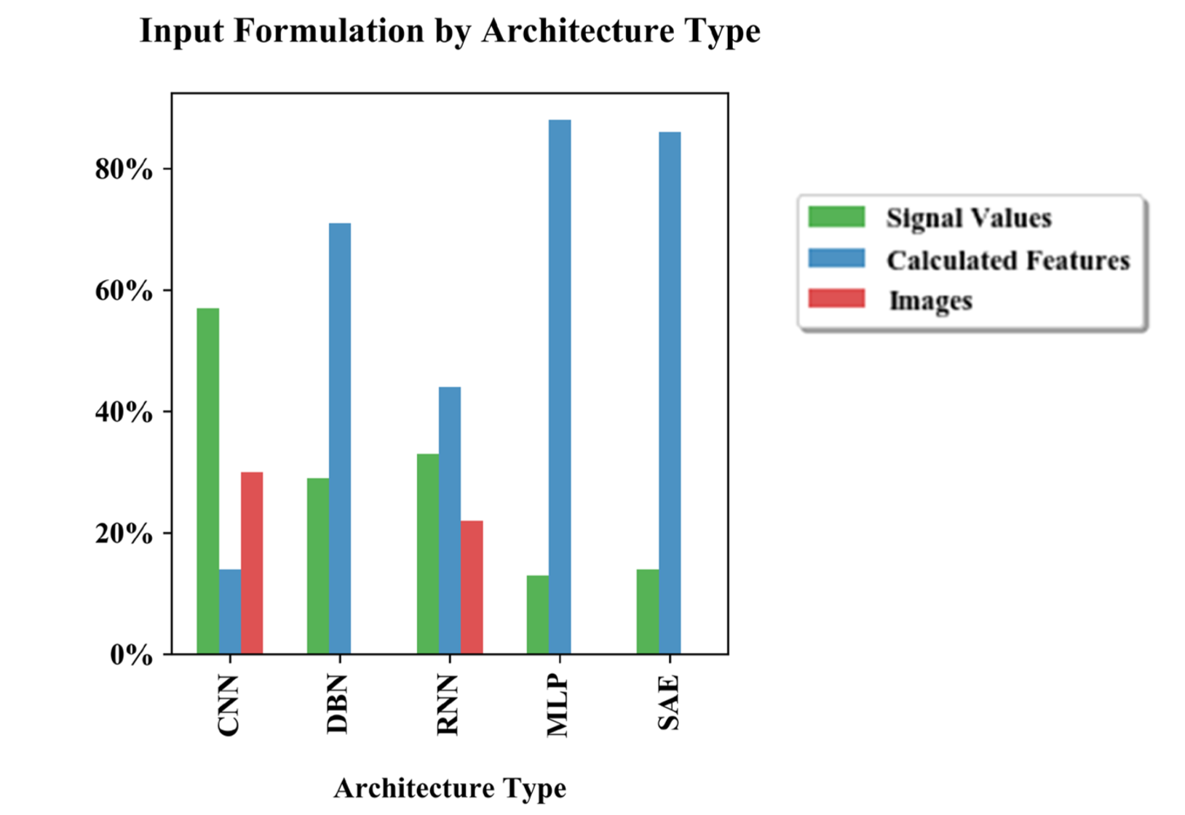
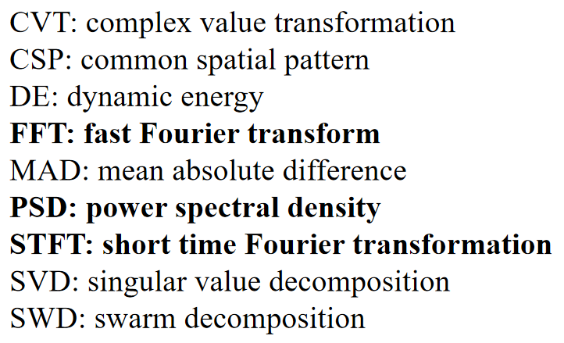
Related Work : EEG Decoding (before deep learning)
Input Formulation by Architecture Type
Feature extraction methods in EEG decoding
CNN architecture with Signal Values as input has higher accuracy.
RNN architecture with Calculated Features as input has higher accuracy.
Most tasks had calculated features as inputs.
Here we use PSD(Power Spectral Density) feature map as traditional feature extration before deep learning feature extraction.

Slide 6
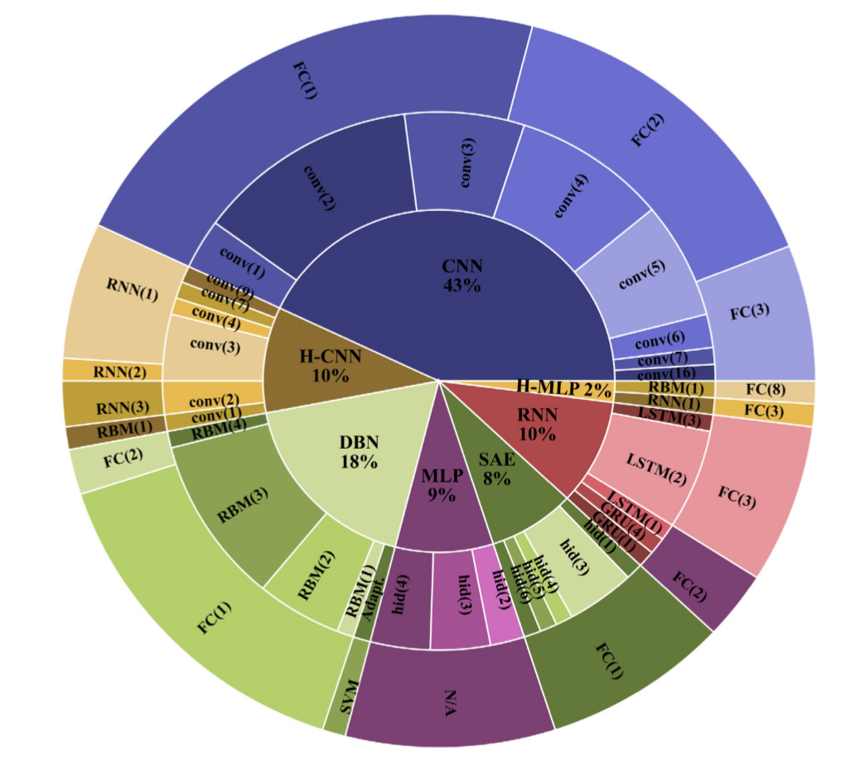
Related Work : EEG Emotion Recognition
2009
2016
2019
Machine Learning techniques such as KNN, RF, SVM, LDA, NB. Only one deep neural network ANN is used.
Deep Learning techniques are applied in this field. Until 2019, over half studies try CNN to solve the signals or images of EEG, while RNN is lack of attention.
Pipline of this project:
Traditional feature extraction from EEG signal;
Deep learning feature extraction based on VGG16;
Emotion recognition based on LSTM.
Comparison of different RNNs.
A 2019th review summarized 90 studies in the use of deep learning for EEG classiﬁcation.
Some studies propose: For EEG emotion recognition,
- RNN has a higher accuracy than CNN.
- LSTM performs better than standard RNN.
- Hybrid architecture performs better than single architecture.
Signal Feature → VGG Feature LSTM/RNN/GRU

Slide 7
PART
Two
Data & Label

Slide 8
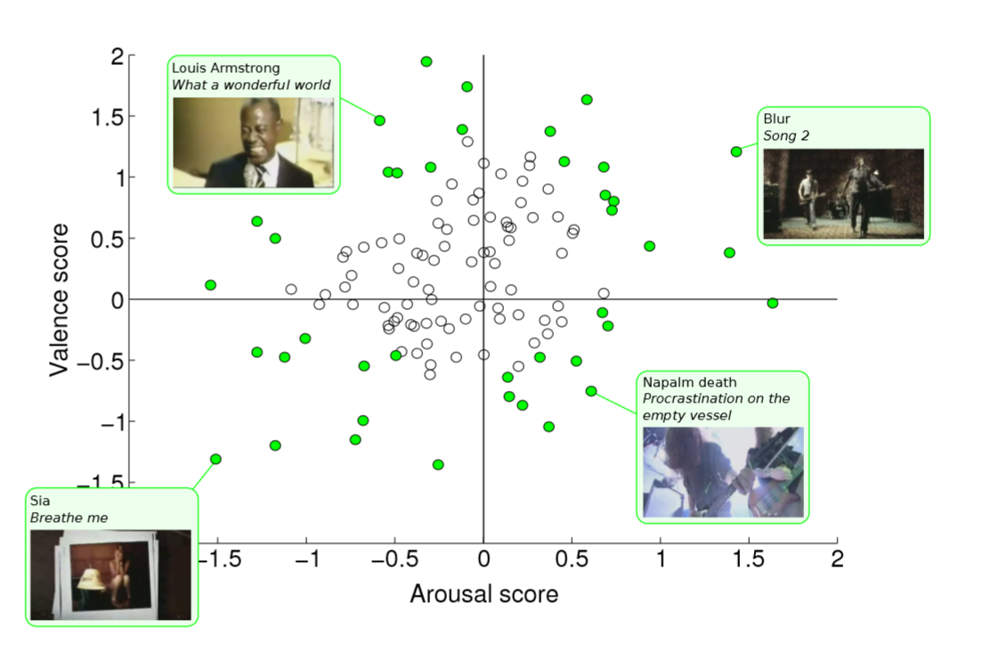
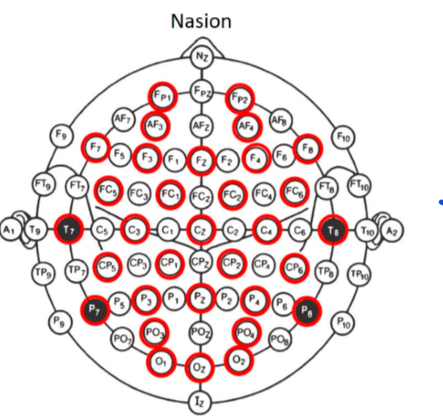
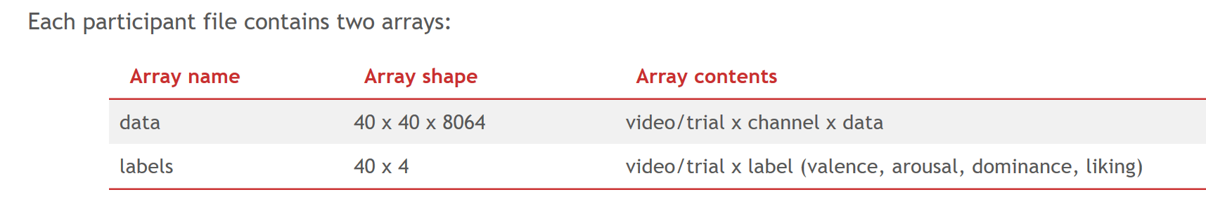
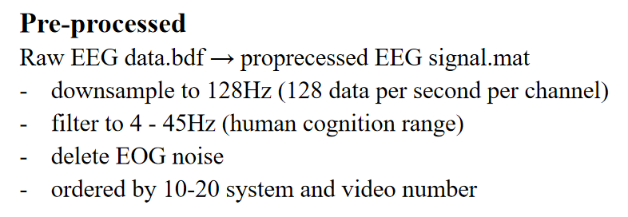
Dataset
Data Source :
Pre-processed EEG data from a publicly available multi-modal emotion dataset DEAP.
https://www.eecs.qmul.ac.uk/mmv/datasets/deap/
DEAP Experiment :
Record EEG signals based on International 10-20 System of 32 participants (50% female).
Stimulus:40 one-minute music videos (4 emotion classes including HVHA/HVLA/LVLA/LVHA,10 videos per class). Each 1-min music video is a trial.
Ratings: arousal,valence,dominance,liking(discrete scale of 1-9) and familiar(discrete scale of 1-5). Every participant watched music videos and make rating per trial.
International 10-20 System:
EEG signal in 32 channels
8064 data=(3s+60s)*128Hz/s
32

Slide 9
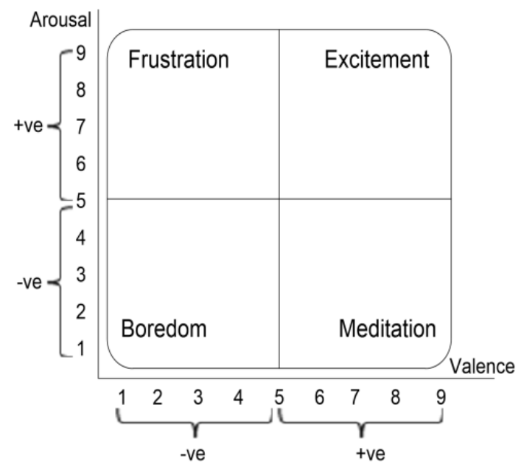
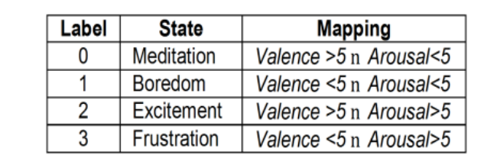
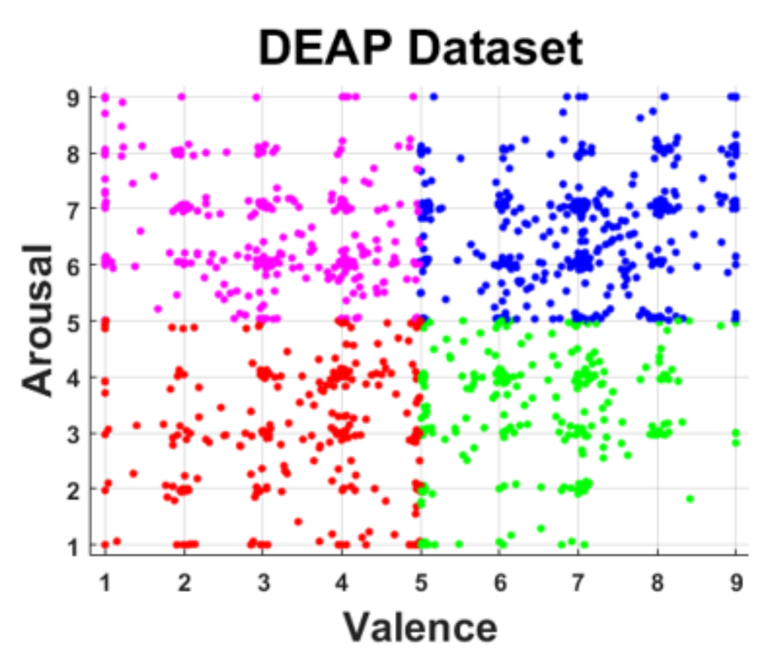
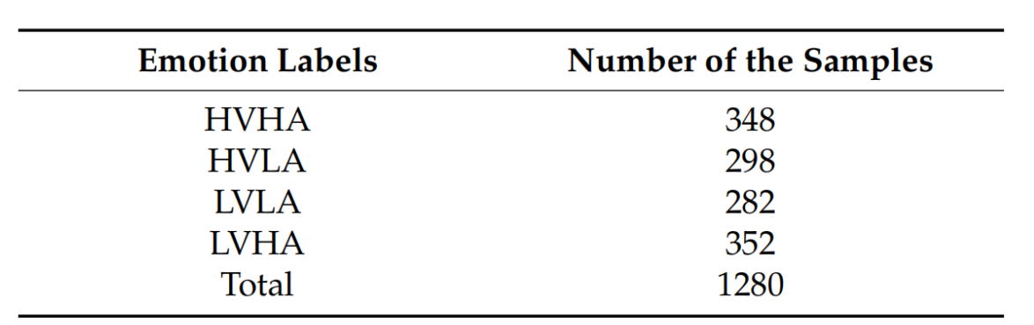
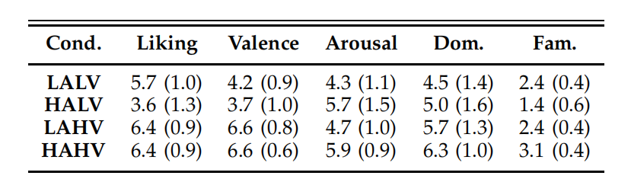
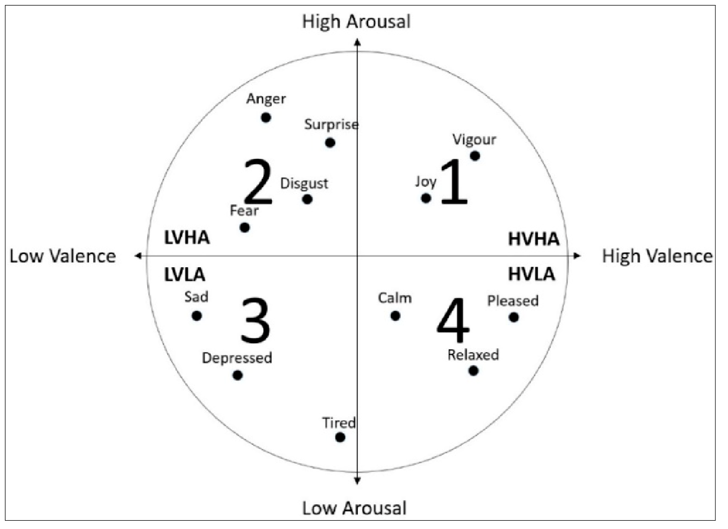
Classification Label
4 Classes:
High Valence High Arousal (HVHA)
High Valence Low Arousal (HVLA)
Low Valence Low Arousal (LVLA)
Low Valence High Arousal (LVHA)
2 Classes for Arousal/Valence/Liking
9 Classes: Vigour/Joy/Anger/Surprise/Disgust/Fear/Sad/Depressed/Tired/Calm/Relaxed/Pleased

Slide 10
PART
Three
Feature
Image Sequence

Slide 11
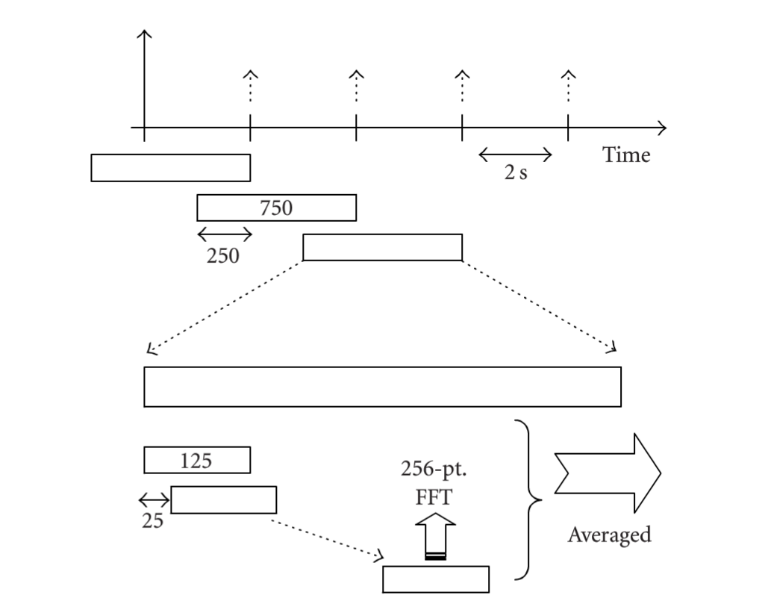
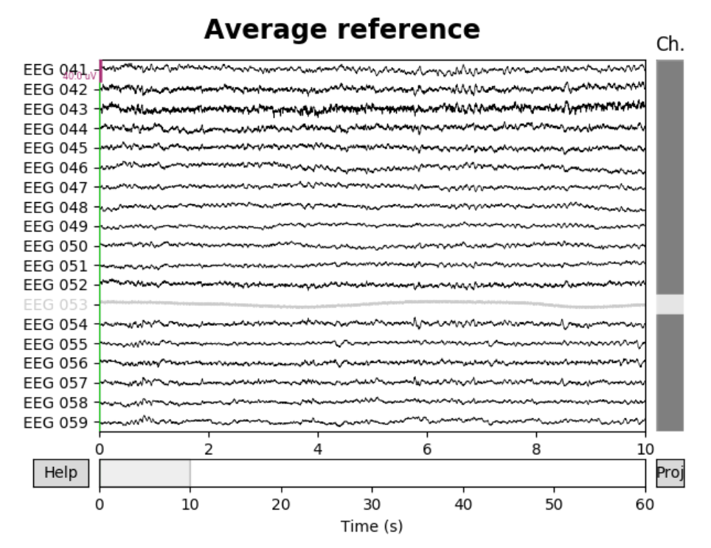
Traditional method for Feature Extraction
Power Spectral Density (PSD) is the magnitude squared of the Fourier Transform of a continuous time and finite power signal.
PSD is FT of Autocorrelation Function of signal.
3 kinds of Signal Domain:
Time Domain (1-60s per trial)
Frequency Domain (4-45Hz, 3 bands)
Space Domain (locations of 32 channels)
Calculate PSD Value: Welth Method
1. The EEG data is divided using half second overlapping hanning window with no overlap for every experiment trial.
2. Each frame was applied for a 256-point FFT by zero-padding.
3. The EEG power spectrum was averaged over total trial length.
block digram for
moving_averaged spectral analysis

Slide 12
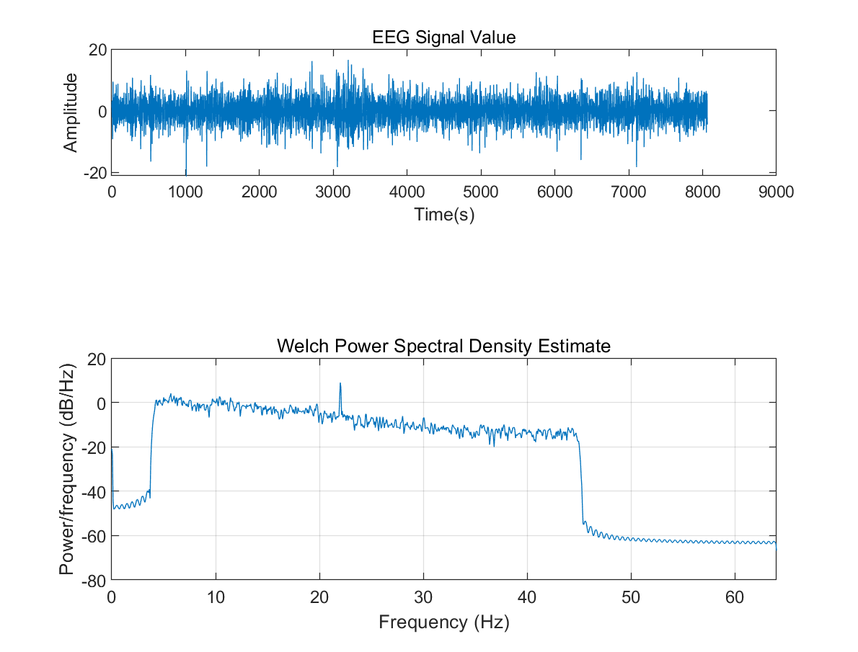
Frequency Domain : 3 bands
However, traditional method
don't take into account the locations of EEG electrodes(space domain) for each EEG band and time domain, only representating frequency domain.
3 EEG bands left account most towards human cognition.
- theta (4-7 Hz): shallow sleep
- alpha (7-13 Hz): awake
- beta (13-30 Hz) : concentrated
theta(4-7Hz)
beta(13-30Hz)
alpha(7-13Hz)

Slide 13
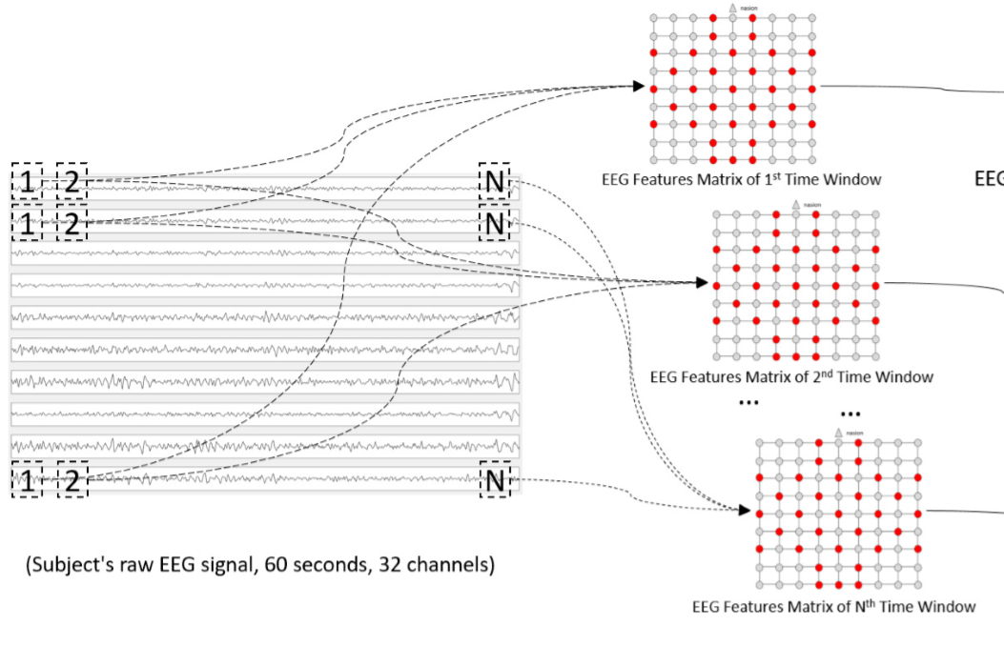
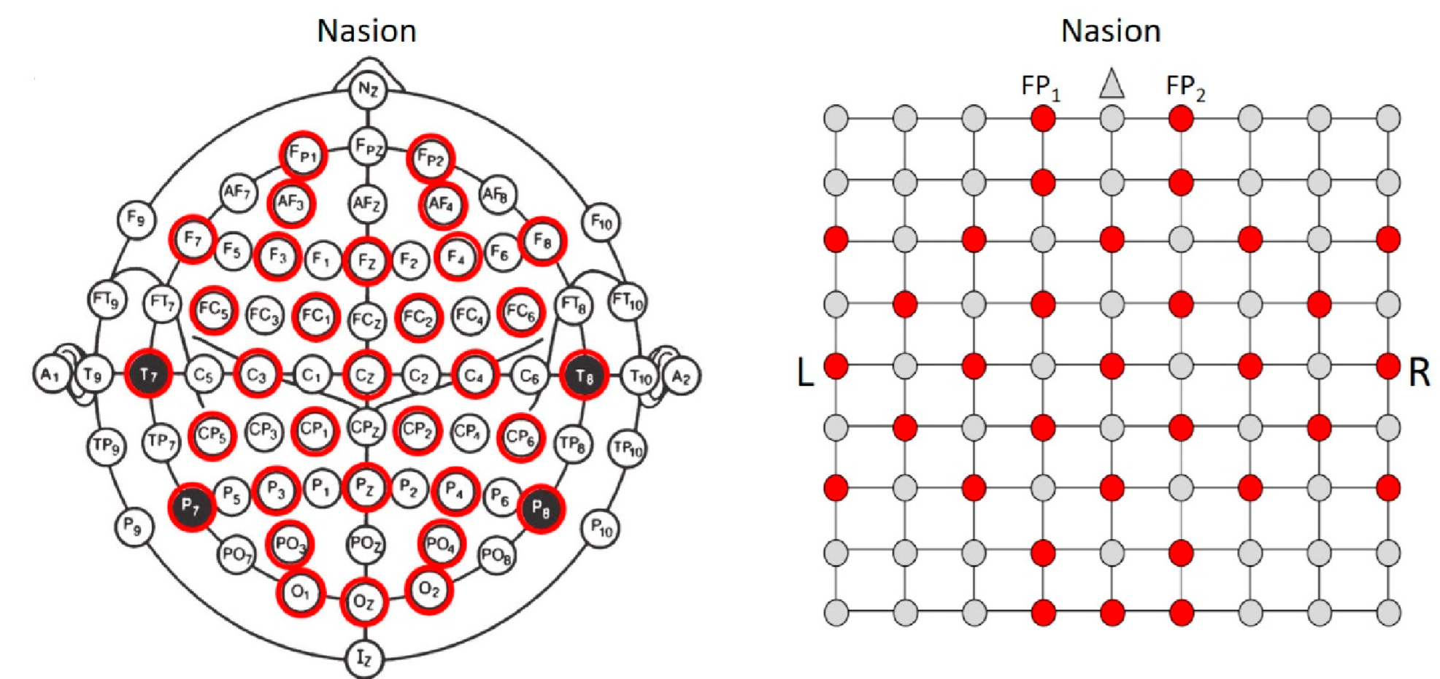
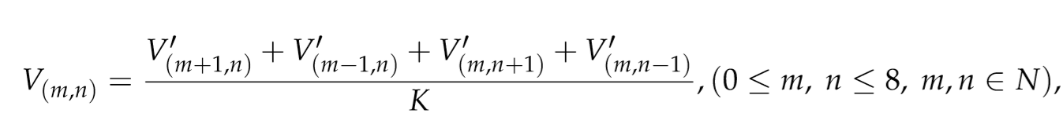
Space Domain: PSD 2-D grid image
1. Calculate the averaged PSD scalars for 32 channel signals.
(EEG signal length = time window length)
time window
2. Fill the other 9*9-32 points:
The value of the red point corresponded to the frequency feature (PSD) of the EEG electrode.
3. Enlarge the image matrix to 224*224
by bicubic interpolation method.

Slide 14
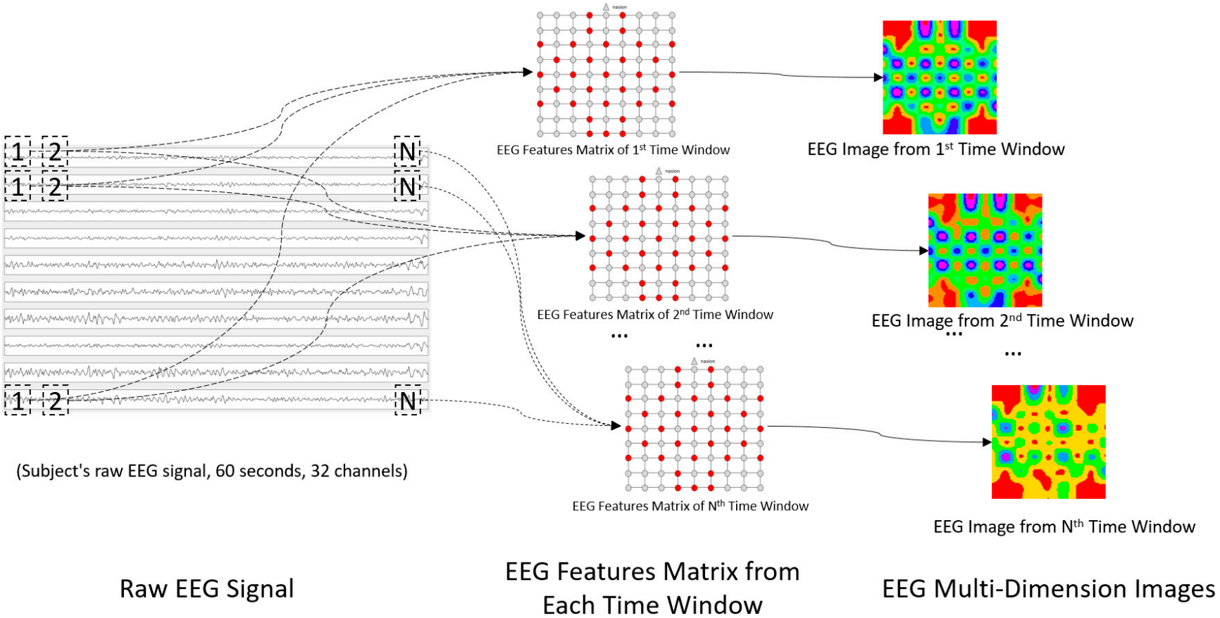
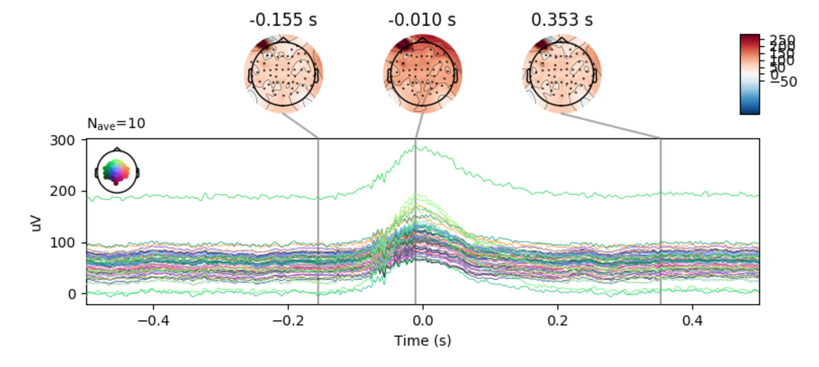
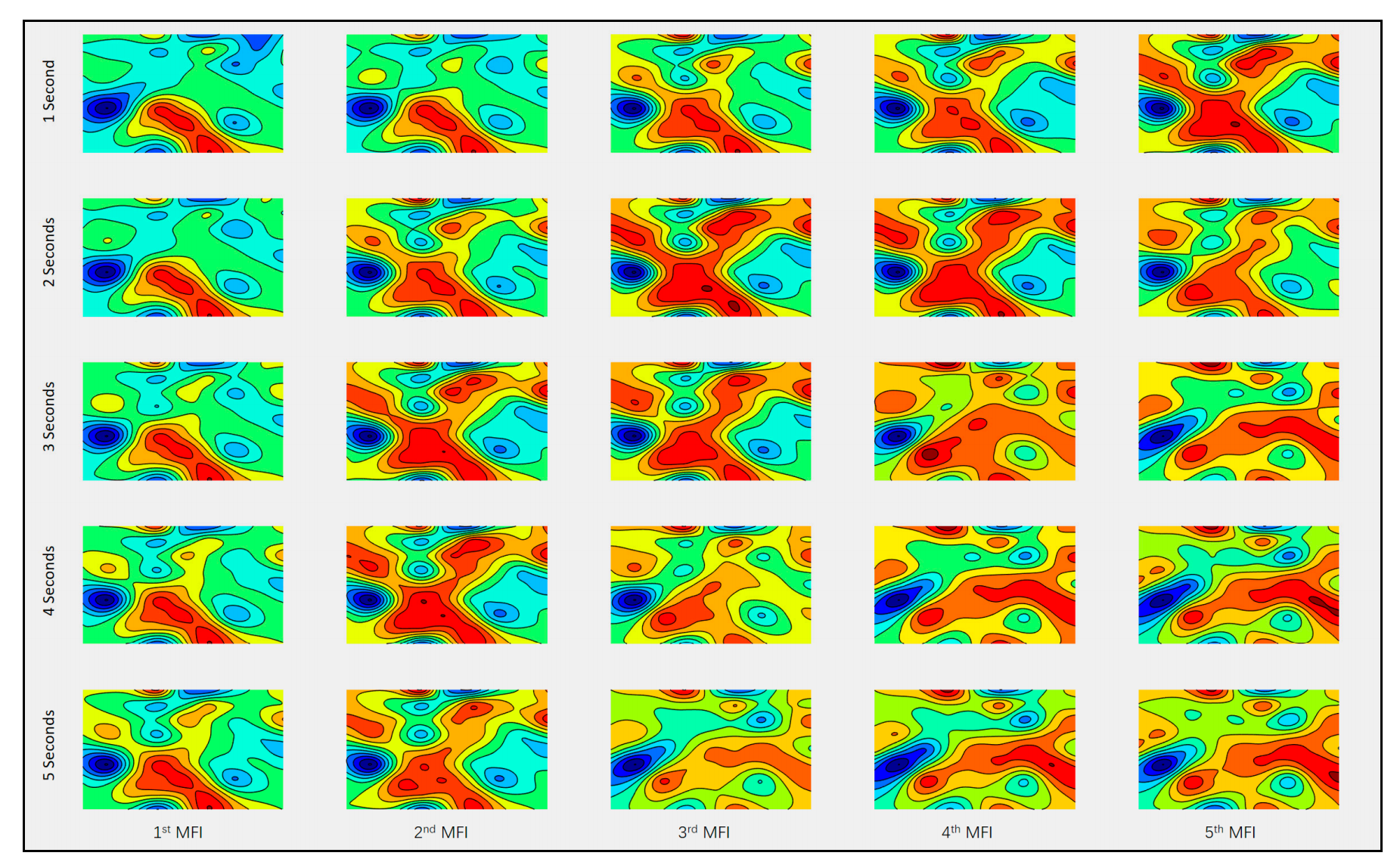
Time Domain: Image Sequence
time window
EEG signal sequence in 1 second
Example on EEG signal of 1st participant & 1st trial:
Column: time window size = 1s, 2s, 3s, 4s, 5s. Row: image sequences.
Sequence(1,5) ≈ Sequence(2,3) : time-varying feature of EEG signal.
What is the best time window size ?
Experiment: time window size = 1s, 2s, 3s, 4s, 5s, 8s, 10s, 12s, 15s, 20s, 30s, 60s.

Slide 15
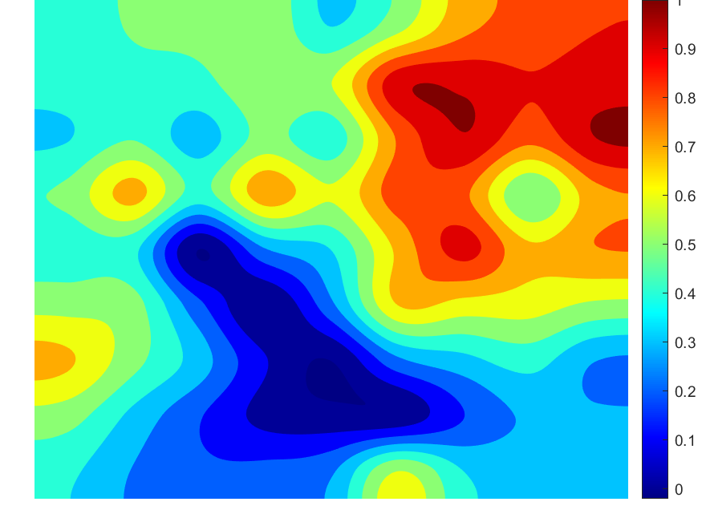
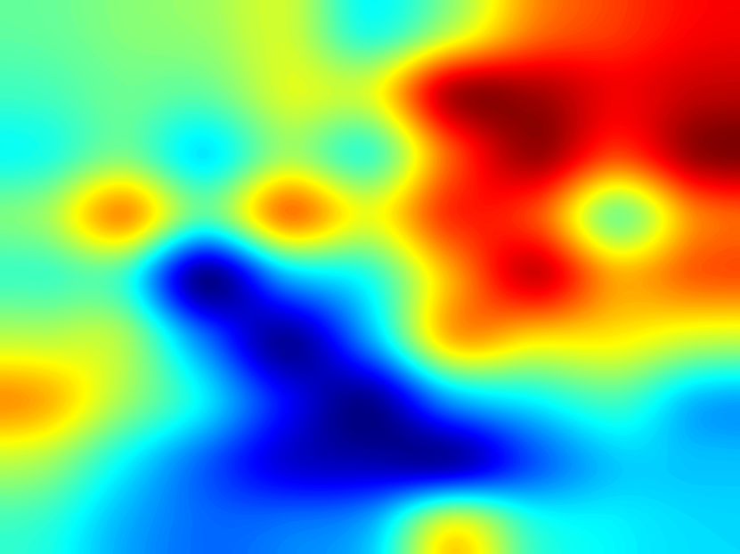
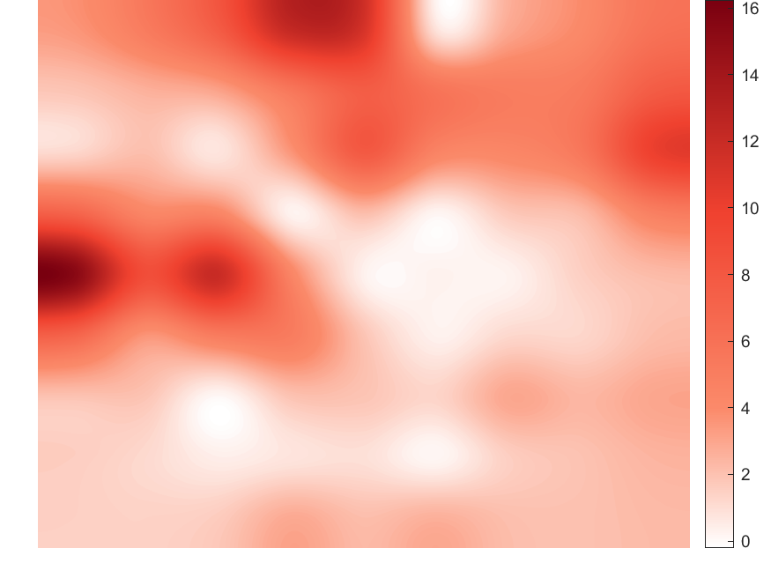
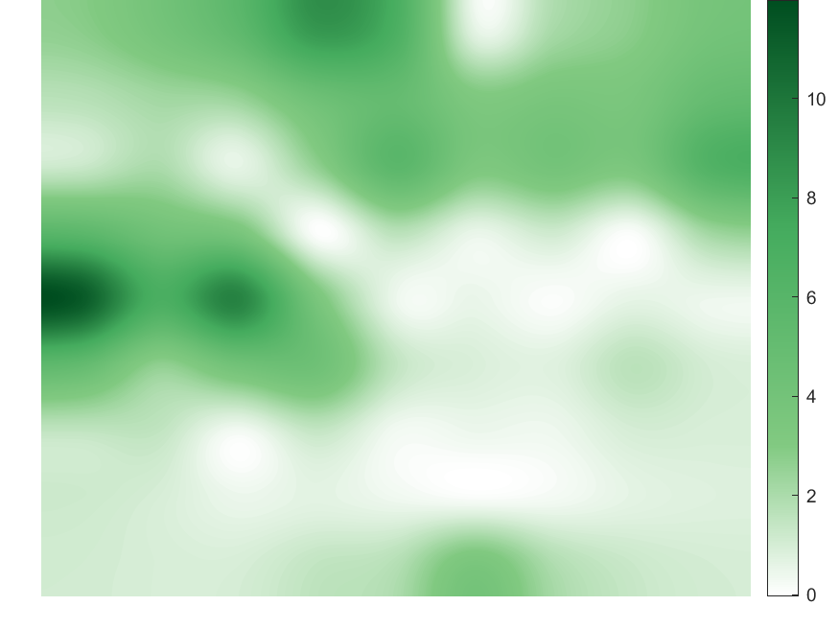
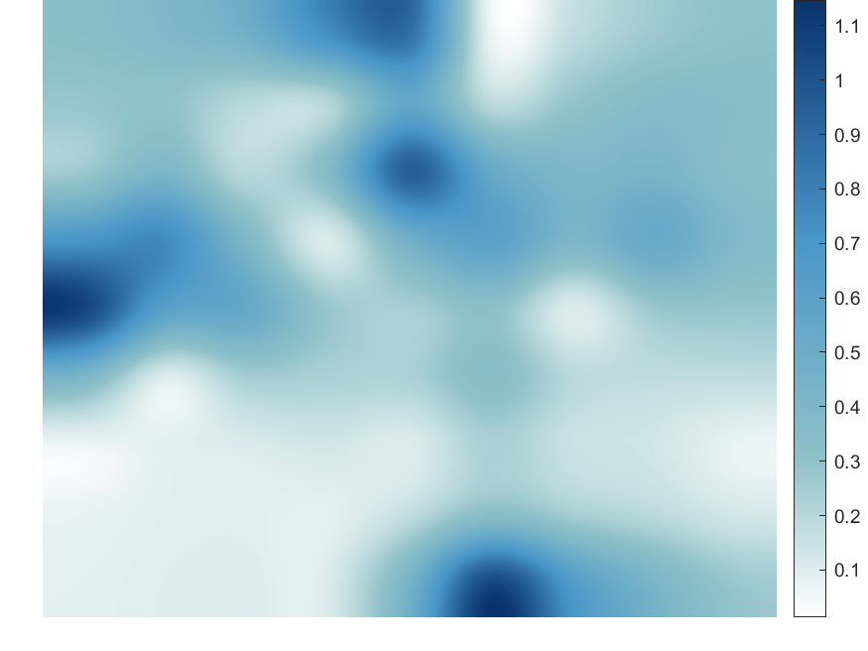

2 kinds of Image Represetation
All band: 2-D Grid Contour Map
3-band combination: Heat Map
theta-band alpha-band beta band combined band
16 contour lines
200 contour lines
Use the EEG-PSD features from traditional method to plot power spectrum heat maps of each EEG band.
Combine three heat maps to an RGB image according to different weights (the ratio of alpha blending).
The deep colorful part represents big PSD value, the shallow colorful part represents small PSD value.
Use the EEG-PSD features from traditional method to plot power spectrum contour maps of EEG full band.
The data is normalized, the red region represents big PSD value, blue region represents small PSD value.
Both spectral and spatial information are represented by a single brain contour map or heat map. Image sequence represents temporal information.

Slide 16
PART
Four
Model

Slide 17

Pipeline
1. Task:
An emotion-classiﬁcation problem based on EEG signals.
Traditional feature extraction: EEG-PSD 2-D contour map sequence (input).
2. Deep learning feature extraction:
Pre-trained VGG-16 network is used for feature extraction.
Salient brain regions under various affective states.
How the power interacts with each other across the different brain regions.
Time-varying features & performance of reccurent network:
Recurrent architecture : LSTM, RNN, Gated Recurrent Unit (GRU).
Dynamic variations of EEG among a complete emotional process.
Recognize affective states(output) according to EEG signals.

Slide 18
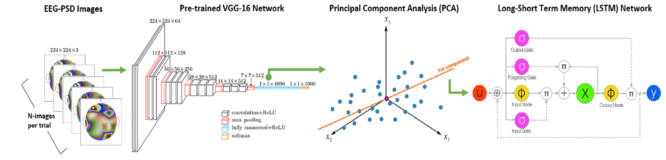
Hybrid Model
Convolutional recurrent hybrid architecture:
traditional feature extraction + pre-trained VGG16 + LSTM, etc.
Process:
Convnet feature learning:
(1) Traditional feature extraction by PSD 2-D Grid Contour Map or Heat Map.
(2) EEG image sequence (n images=60s/time window size) per trial is resized and submitted to VGG16 network.
(3) Principal component analysis is applied to feature space of the last but one layer to reduce feature dimension from 4096 to 30 per trial.
Temporal feature aggregation:
The 30*n features (n images) are sent to LSTM or other recurrent networks.
Finally, Class prediction.

Slide 19

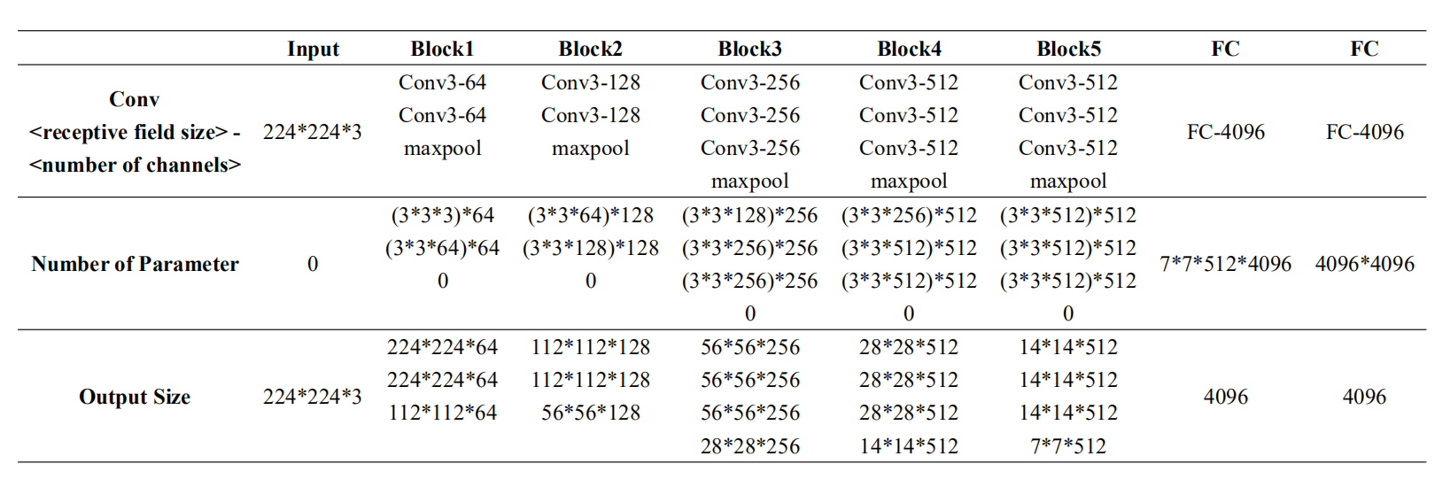
Deep Learning Feature Extraction - VGG16 network
This network is pre-trained with more than a million images for 1,000 object categories using the Imagenet Database.
1. Contour image sequence (224×224×3 size, image number = 60/time window length) with labels (ratings) is resized and submitted to VGG-16 network.
2. PCA is applied to feature space of the last but one layer to reduce the feature dimension (4096 to 30 features) for each trial.

Slide 20
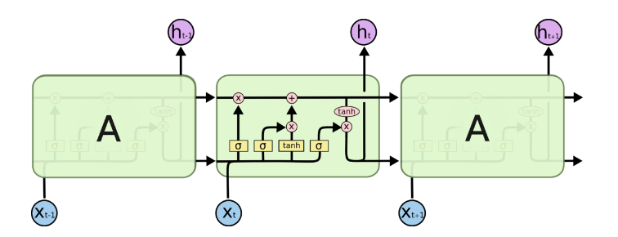
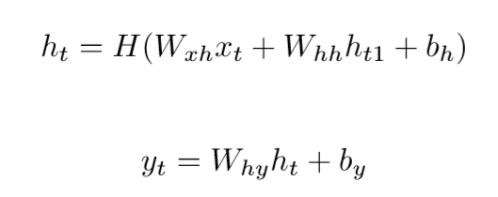
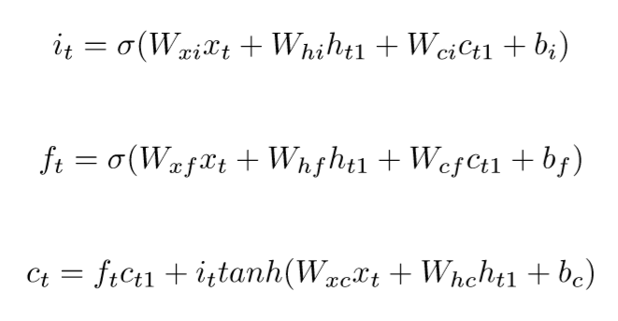
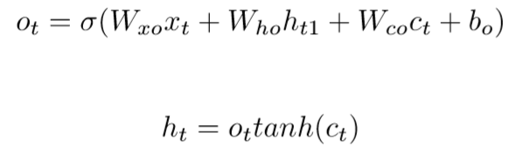
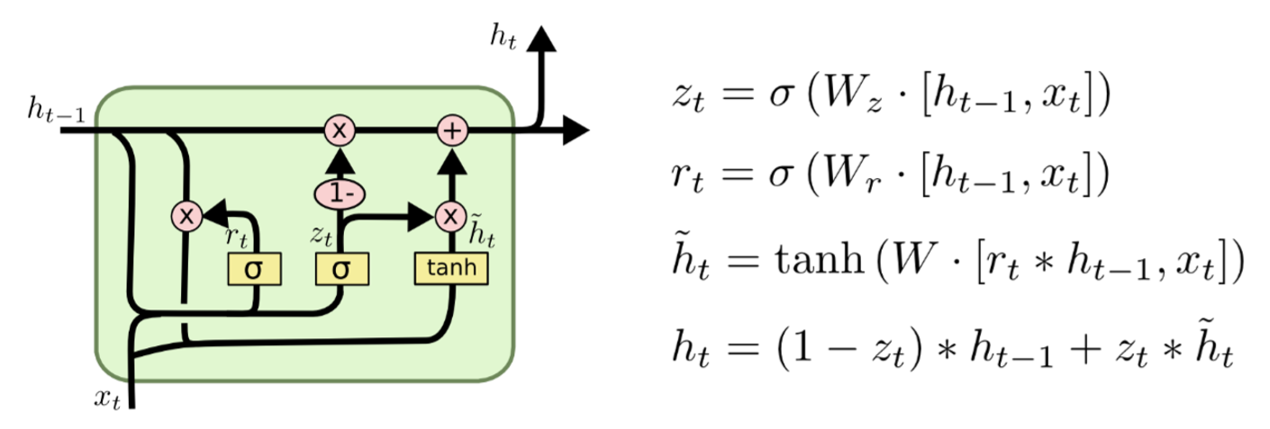
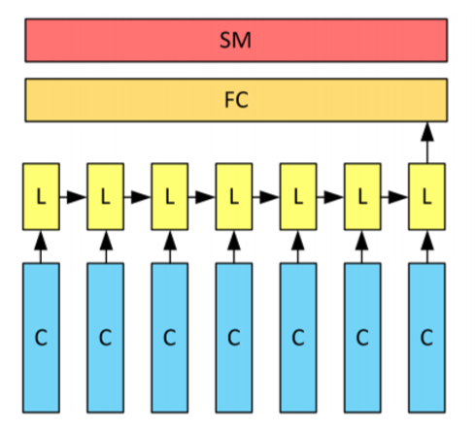
Reccurent nueral networks
Reccurent nueral networks can capture variations of VGG16 activated sequence in a short interval, which reﬂects subtle changes of subject’s emotional state.
In order to explore the most effective recurrent unit, the ﬁnal accuracies of different types of RNN variant architectures will be compared.
Comparison of RNN, LSTM and GRU
LSTM
RNN is traditional sequence model with a large number of cells, resulting in the problem of gradient explosion and disappearance. RNN is not sensitive to the relationship between long-distant cells.
LSTM adopted gate method to solve the gradient explosion of RNN, and used cell state to save the long-term memory, preventing them covered by short-term memory.
GRU as a easy version of LSTM. GRU has one third less parameters than LSTM, so it converges faster and is not susceptible to overﬁtting.
Input gate, forget gate, output gate and cell activation vectors are denoted, respectively, as i, f, o, and c. σ is the logistic sigmoid function.
GRU
C: VGG16 layers without last layer;
L: LSTM layer (128 units);
FC: fully-connected layer;
SM: softmax layer.

Slide 21
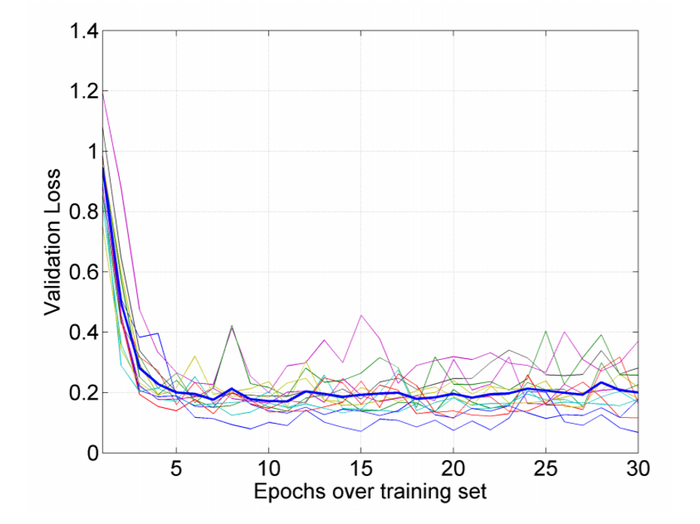
Training
80/20 data set ratio
10-fold cross-validation
batch size = 50
Recursive networks are trained by optimizing the cross-entropy loss and adopting Adam algorithm (learning rate = 10e-4).
Because VGG16 has a small kernel size and a large depth, it forms implicit regularization.
Overfitting Problem
Dropout: drop rate in FC layers = 0.5
Early Stopping: performance in a randomly selected validation set per epoch.
Data Argumentation: At least 20,000 images for each epoch.
random_flip_left_right
random_contrast
image_standardization
× Adding noise to images increases the error rate.
p.s. For different time window sequences, parameters for data augmentation are different.
e.g. Time window of 1s ~ 3s, data augmentation is not needed.

Slide 22
PART
Five
Evaluation

Slide 23
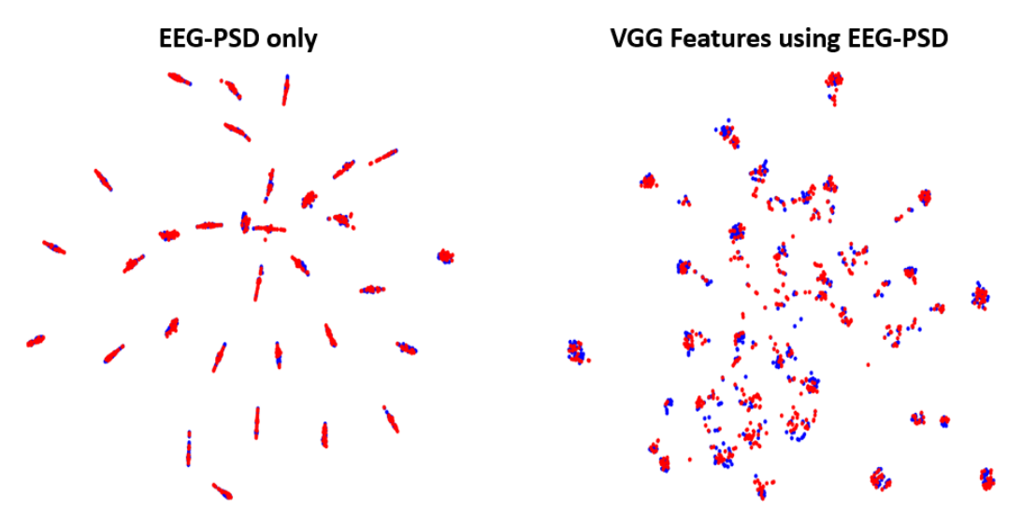
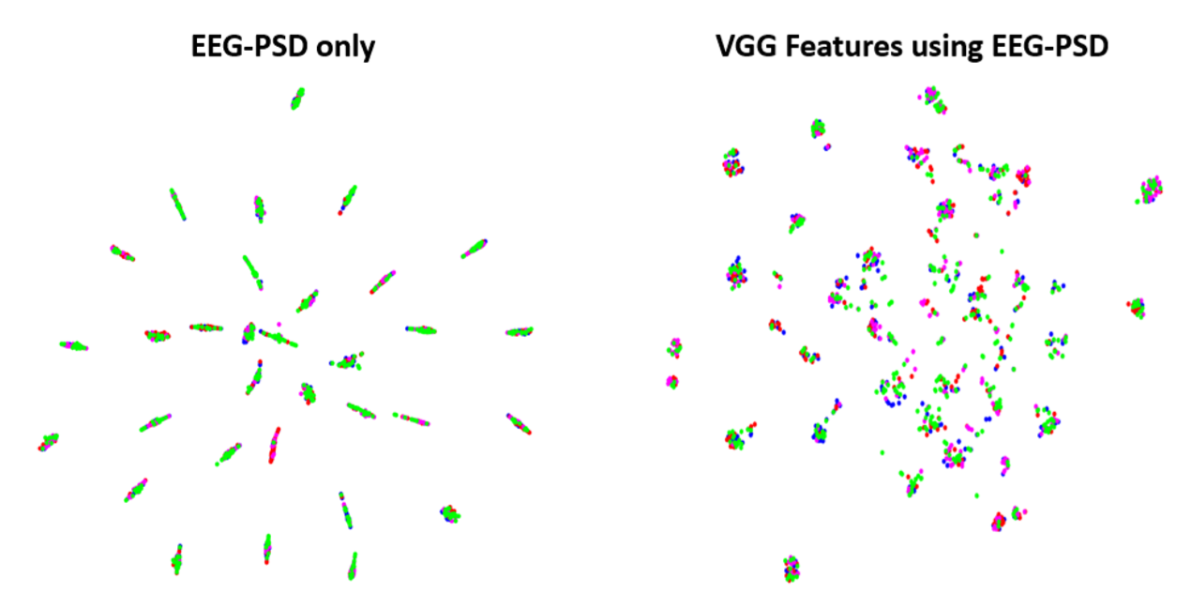
Class-separability of traditional vs. deep-learning features
Deep-learning features allow for better class separation.
Traditional feature can only form an EEG data cluster for each participant.
Feature spaces on 2 valence classes
(low-valence in blue, high-valence in red)
Feature spaces on 4 emotion classes
(HVHA in blue, LVHA in red, LVLA in magenta, and HVLA in green)

Slide 24
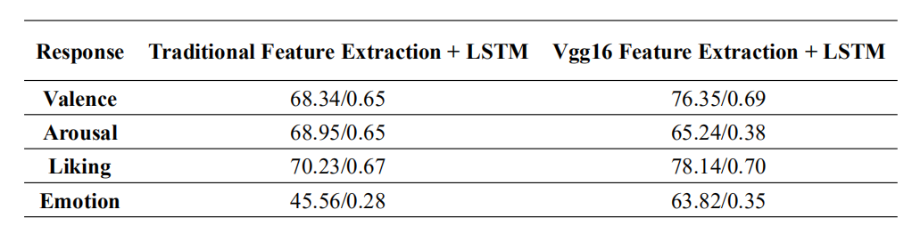
Evaluation performance of diﬀerent feature-extraction methods
Deep learning method is better than traditional feature-extraction method.
Accuracy of Liking condition is better than the other conditions.
Maybe the subjective judgement of participants for liking response is more accurate than others.
Reason for bad performance of classiﬁer on Emotion response situation.
Although the participants rating some trials as mediation (HVLA) and bored (LVLA), maybe their brain activity is still in the other frequency band.
Table shows accuracy / F1-score.
Classification of valence/arousal/liking/emotion using traditional feature sequences as input(left) and VGG-feature sequences as input(right).
Notes:
Maybe the subjective judgement of participants for liking response is more accurate than others, because human being
can always explain favor and hate, but sometimes do not care about valence or arousal aﬀecting.

Slide 25
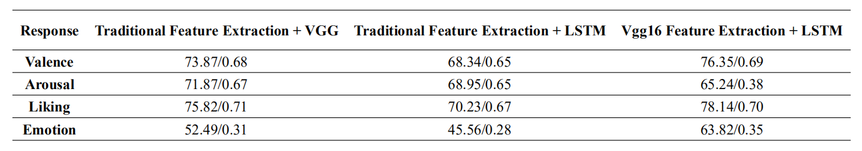
Evaluation performance of convolutional network and recurrent network
2 3 1
Table shows accuracy / F1-score.
Classification of valence/arousal/liking/emotion using single convolutional network(left), single recurrent network(middle) and hybrid network(left).
Comparison
Convolutional network can capture most signiﬁcant features.
If we only use LSTM to deal with the PSD signal, some features will lose.
Performance of Hybrid architecture is a little bit better than convolutional network and much better than recurrent network.
Inference
VGG16 is used to learn temporary image patterns from EEG frequency image sequences, which is very important for the ﬁnal classiﬁcation performance.
LSTM network is used to recognize the variations among image sequence in the whole trial.

Slide 26
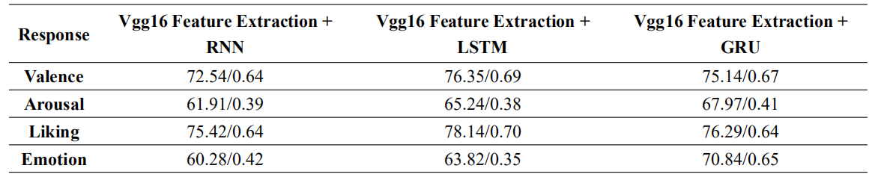
Evaluation performance of different recurrent networks
Table shows accuracy / F1-score.
Time window size used here is l second.
Classification of valence/arousal/liking/emotion using deep learning feature sequences as input with different recurrent networks.
Comparison
Accuracy of RNN is not ideal.
The performance of GRU and LSTM is similar,
except that GRU performs better than LSTM in
the emotion condition.
Inference
RNN may not capture the information of long signal image sequence.
GRU has less parameters than LSTM, preventing overfitting.

Slide 27
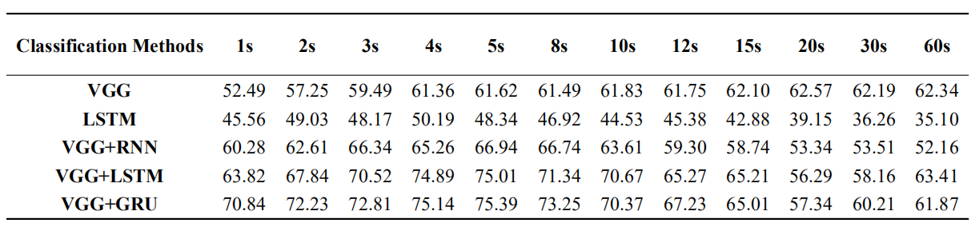
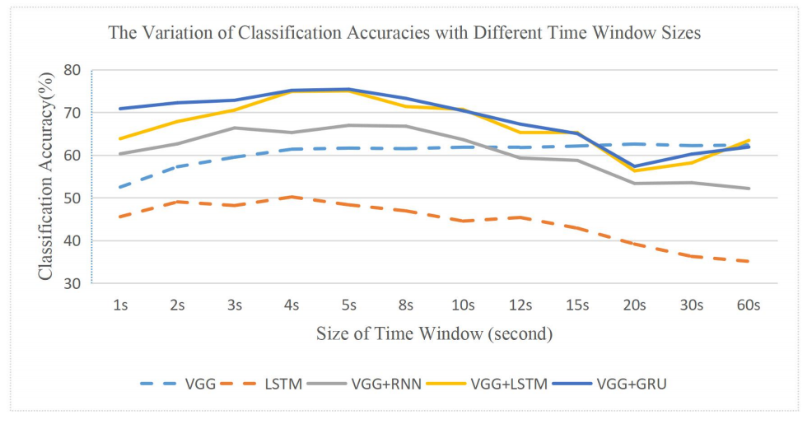
Evaluating performance among diﬀerent time window sizes
Assumption: Time window size affects the performance of classifiers.
→To find the most approximate time-window length to create EEG frequency image sequence.
Average value of emotion classiﬁcation accuracy (32 participants) with diﬀerent time window size.
Comparison
All recurrent models show sensitivity to the size of time window. The convolution method is not sensitive.
LSTM and GRU with deep learning feature extraction have higher accuracies than other models.
After around 10 seconds, classiﬁcation accuracy showed an obvious decreasing trend.
Inference
Small time window may loss some continuous information in a complete process of emotional variation.
As time window becomes larger, changes in EEG signal are sheltered. Image sequence with large-sized time window can not reﬂect the subtle variation of human emotion.
The most ﬁtting time is around 5 seconds.

Slide 28
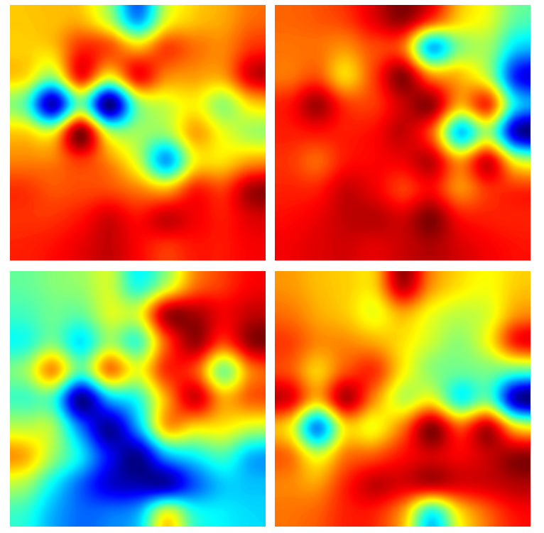
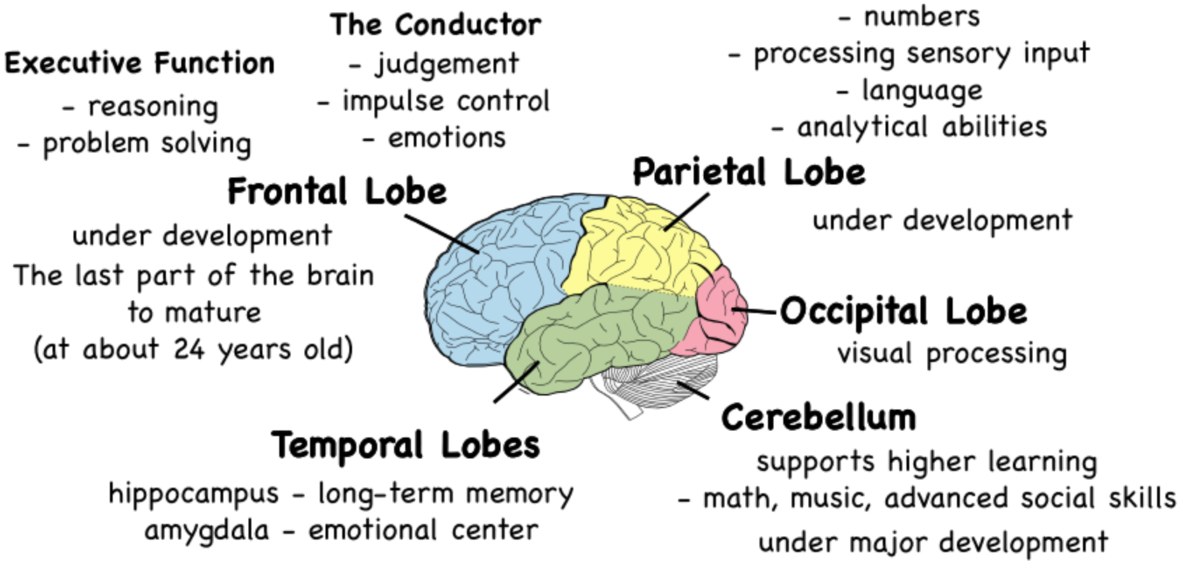
Relationship between EEG signal distribution in brain & Eﬀective states
3
1
2
4
V-A plane
Inference
Arousal value is bigger, the excited brain area (with strong signal) is bigger.
Typical images for 4-category emotion, corresponding to V-A plane left.
High arousal state may be related with temporal lobe (emotional center and in charge of long-term memory).
Valence might be related to frontal lobe (in charge of rational thinking). Strong EEG signal in frontal lobe occurs if the participant takes a high valence of himself.
Occipital lobe is in charge of visual processing. Strong signal occurs in this region except the boring state.
Excited state: most brain areas has strong EEG signal. Frontal,temporal and occipital lobe is active in particular.
Boring state: most brain areas merely has little EEG signal (inactivity).
Frustrated state: signal in frontal lobe is weak, which results in brain is out of control of rational thinking, while temporal lobe has strong signal, maybe because a person memorize negative long-term memories if he or she feel frustrated.
Mediation state: signal in temporal and parietal lobe is weak; signal in frontal and occipital lobe is strong. Person in mediation state is isolated from surroundings, focusing on video.

Slide 29
PART
Six
Conclusion

Slide 30
Conclusion
This study tries new signal processing way with deep learning method, an eﬀective method for EEG feature extraction and representation. The EEG image sequence can fuse the spatial, spectral and temporal features of EEG signal. (The method is to extract EEG frequency features (PSD) from diﬀerent EEG channels and map them to a two-dimensional matrix, in order to construct an EEG-PSD image sequence.)
VGG16 deep learning method can capture more signiﬁcant features than traditional feature extraction way.
VGG16 is used to learn temporary image patterns (fixed image modes) from EEG frequency image sequences, saving the important eternal features in speciﬁc emotional states . LSTM network is used to recognize the variations among image sequence(dynamic features) in the whole trial.
The most proper time window size is not the longest and shortest, but the one best matching with a period of human cognition process, commonly with a length around 5 seconds.
Diﬀerent brain lobes have special relationship with human aﬀective response. The high valence is related to frontal lobe; the arousal has positive correlation with active brain area (area with strong EEG signal); temporal lobe is related to Low Valence How Arousal (LVHA) (strong negative aﬀective state); occipital lobe may be related to visual processing activity.
The sensitivity and accuracy of human subjective judgment about Liking, Arousal and Valence is decreasing in order.
Notes:
This project focuses on training an instance-level generator to transfer an arbitrary assigned make-up style to an arbitrary human face. After comparison, we decide to train our model based on Cycle-GAN structure.

Slide 31
THANKS

Slide 32
References
[1] Duvinage, M., Castermans, T., Petieau, M., Hoellinger, T., Cheron, G. and Dutoit, T., 2013. Performance of the Emotiv Epoc headset for P300-based applications. Biomedical engineering online, 12(1), p.56.
[2] Poh, M.Z., Swenson, N.C. and Picard, R.W., 2010. Motion-tolerant magnetic earring sensor and wireless earpiece for wearable photoplethysmography.IEEE Transactionson Information Technologyin Biomedicine, 14(3), pp.786-794.
[3] Ehmen, H., Haesner, M., Steinke, I., Dorn, M., Gvercin, M. and Steinhagen-Thiessen, E., 2012. Comparison of four different mobile devices for measuring heart rate and ECG with respect to aspects of usability and acceptance by older people. Applied ergonomics, 43(3), pp.582-587.
[4]VERY DEEP CONVOLUTIONAL NETWORKS FOR LARGE-SCALE IMAGE RECOGNITION,Karen Simonyan, Andrew Zisserman, ICLR 2015
[5]Alarcao,S.M.andFonseca,M.J.,2017.Emotions recognition using EEG signals: a survey. IEEE Transactions on Affective Computing.
[6]Utilizing Deep Learning Towards Multi-modal Bio-sensing and Vision-based Affective Computing, Siddharth, arXiv:1905.07039v1 [cs.LG] 16 May 2019
[7]DEAP: A Database for Emotion Analysis using Physiological Signals, Sander Koelstra,IEEE TRANS.AFFECTIVE COMPUTING

Slide 33
References
[8]Review Article:A Review on the Computational Methods for Emotional State Estimation from the Human EEG
[9]Review and Classification of Emotion Recognition Based on EEG Brain-Computer Interface System Research: A Systematic Review.
[10]Zheng,W.L.;Lu,B.L.Investigating critical frequency bands and channels for EEG-based emotion recognition with deep neural networks. IEEE Trans. Auton. Ment. Dev. 2015, 7, 162–175.
[11]Shen, X.B.; Wu, Q.; Zhao, K.; Fu, X.L. Electrophysiological evidence reveals differences between the recognition of microexpressions and macroexpressions. Front. Psychol. 2016, 7.
[12]Soleymani, M.; Asghari-Esfeden, S.; Fu, Y.; Pantic, M. Analysis of EEG signals and facial expressions for continuous emotion detection. IEEE Trans. Affect. Comput. 2016, 7, 17–28.
[13] Bozhkov, L.; Koprinkova-Hristova, P.; Georgieva, P. Learning to decode human emotions with echo state networks. Neural Netw. 2016, 78, 112–119.
[14] Chai, X.; Wang, Q.S.; Zhao, Y.P.; Liu, X.; Bai, O.; Li, Y.Q. Unsupervised domain adaptation techniques based on auto-encoder for non-stationary EEG-based emotion recognition. Comput. Biol. Med. 2016, 79, 205–214.
[15]Deep learning for electroencephalogram (EEG) classification tasks: a review.

